Slide 1


Abhishek Bhargava
Michael You
15-424: Final Project

Slide 2
Markets are becoming more complex
Big data and more financial assets
Difficult to accurately model
Global models don’t perform well
Need local models based on world state
2008 Recession
2010 Flash Crash

Slide 3
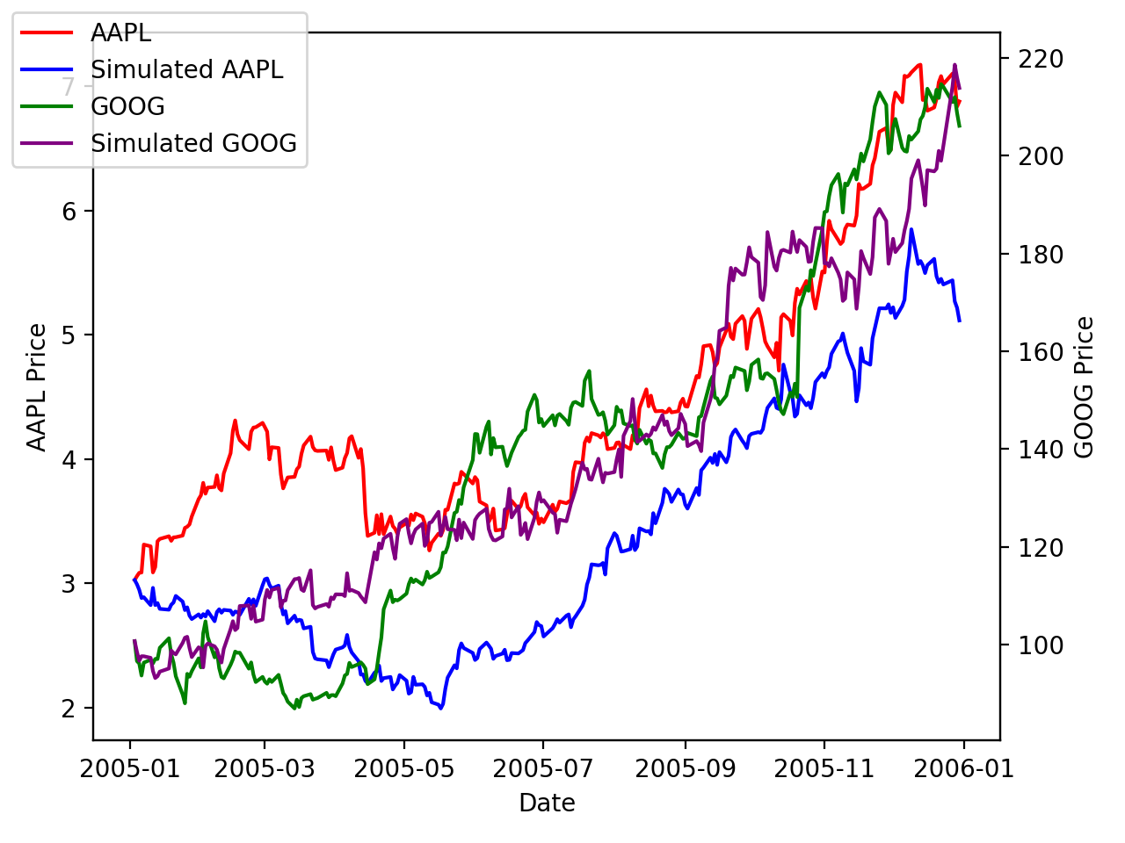

Brownian Motion is Essential to Market Simulation
Random evolution
Suspended particles in fluid
$ⅆS_{t}=S_{t}(μⅆt+σⅆB_{t})$
Stock prices follow
correlated GBMs

Slide 4
SMC can make safety guarantees about trading strategies
Markov Decision Process
Bound the probability that we lose money
Henriques et al. 2012: resolve nondeterminism

Slide 5

Definitions

Slide 6

Trader and Scheduler
Trader
Chooses a strategy
How to allocate wealth in each time period
Goal: Make as much money as possible
Scheduler
Chooses “world state” - how the market behaves
Tries to make trader lose money

Slide 7

Assets and Portfolio
Controlled by the trader
8 assets
7 stocks
1 risk-free
Allocation vector
$$\left[\begin{matrix}Bank \\ AAPL \\ \begin{aligned}MSFT \\ GOOG \\ F \\ JNJ \\ JPM \\ XOM\end{aligned}\end{matrix}\right]=\left[\begin{matrix}0.1 \\ 0.2 \\ \begin{aligned}0.1 \\ 0.1 \\ 0 \\ −1 \\ 1 \\ 0.5\end{aligned}\end{matrix}\right]$$

Slide 8


World States
Influences how stock prices behave
$μ$: drift
$Σ$: volatility
Based on S&P500
Ex: S&P500 going up in price
Transition to other world states
$$C=\left[\begin{matrix}1 & 0 & 1 & 0 \\ 1 & 1 & 1 & 1 \\ 1 & 1 & 1 & 1 \\ 0 & 1 & 0 & 1\end{matrix}\right]$$
Transition matrix for 4 world states
Notes:
World states -> describe how you think the world will evolve

Slide 9

Model

Slide 10

New probabilistic syntax to $SⅆL$
$$⟦{\left[α\right]}_{θ}P⟧=\left\{\begin{aligned}ω | ν∈⟦P⟧ for at most θ proportion \\ of all ν such that \left(ω, ν\right)∈⟦α⟧\end{aligned}\right\}$$
Defined for a finite state space

Slide 11
Model
Preconditions
Hybrid Program
Postcondition

Slide 12

Preconditions
$T_{0}>0$ : duration of each iteration
$X>0$ : Starting portfolio value
$J∈\{J_{1},J_{2},…, J_{N_{J}}\}$ : starting world state
$S_{i}>0$: all stock prices are positive

Slide 13
Hybrid Program
Trader chooses allocation
Scheduler chooses next world state
Run market simulation
Repeat indefinitely

Slide 14


Postcondition and Formula
$φ≔X<X_{0}$ : trader loses money
Let $θ$ be the probability we want to prove
$$PRE→{⟦HP⟧}_{θ}φ$$

Slide 15
Simulation & Training

Slide 16

Market Simulation
Given a set of world transitions, for each transition:
Let trader choose portfolio allocation
Stock prices evolve according to correlated GBMs
Stock returns → portfolio returns ($α^{T}⋅R$)
Use historical data to compute parameters for each world state
Calculate Sharpe ratio

Slide 17
Making an Evil Scheduler
Find optimal adversarial scheduler
Algorithm based on Henriques et al. 2012
Reinforcement learning
Evaluate
Improve
Optimize

Slide 18


Training example: Evaluate
$$\left[\begin{matrix}0.08 & 0.92 & 0 & 0 & 0 & 0 & 0 & 0 \\ 0.04 & 0.15 & 0.81 & 0 & 0 & 0 & 0 & 0 \\ 0 & 0.05 & 0.15 & 0.80 & 0 & 0 & 0 & 0 \\ 0 & 0 & 0.8 & 0.18 & 0.02 & 0 & 0 & 0 \\ 0 & 0 & 0 & 0.55 & 0.27 & 0.18 & 0 & 0 \\ 0 & 0 & 0 & 0 & 0.98 & 0.02 & 0 & 0 \\ 0 & 0 & 0 & 0 & 0 & 0.85 & 0.15 & 0 \\ 0 & 0 & 0 & 0 & 0 & 0 & 1 & 0\end{matrix}\right]$$
$$p=0.95$$

Slide 19


Training example: Improve
$$q=\left[\begin{matrix}1 & 0.98 & 0 & 0 & 0 & 0 & 0 & 0 \\ 0.88 & 099 & 0.99 & 0 & 0 & 0 & 0 & 0 \\ 0 & 0.99 & 0.99 & 0.99 & 0 & 0 & 0 & 0 \\ 0 & 0 & 0.99 & 0.99 & 0 & 0 & 0 & 0 \\ 0 & 0 & 0 & 1 & 1 & 1 & 0 & 0 \\ 0 & 0 & 0 & 0 & 1 & 1 & 0 & 0 \\ 0 & 0 & 0 & 0 & 0 & 1 & 0 & 0 \\ 0 & 0 & 0 & 0 & 0 & 0 & 1 & 0\end{matrix}\right]$$
$$New Scheduler$$

Slide 20

Training example: Evaluate
$$\left[\begin{matrix}0.04 & 0.96 & 0 & 0 & 0 & 0 & 0 & 0 \\ 0.03 & 0.56 & 0.42 & 0 & 0 & 0 & 0 & 0 \\ 0 & 0.02 & 0.66 & 0.32 & 0 & 0 & 0 & 0 \\ 0 & 0 & 0.8 & 0.2 & 0 & 0 & 0 & 0 \\ 0 & 0 & 0 & 0.2 & 0.28 & 0.52 & 0 & 0 \\ 0 & 0 & 0 & 0 & 0.96 & 0.04 & 0 & 0 \\ 0 & 0 & 0 & 0 & 0 & 0.55 & 0.45 & 0 \\ 0 & 0 & 0 & 0 & 0 & 0 & 1 & 0\end{matrix}\right]$$
$$p=0.95$$

Slide 21


Training example: Converge
$$\left[\begin{matrix}0.02 & 0.98 & 0 & 0 & 0 & 0 & 0 & 0 \\ 0.09 & 0.90 & 0.01 & 0 & 0 & 0 & 0 & 0 \\ 0 & 0.57 & 0.16 & 0.27 & 0 & 0 & 0 & 0 \\ 0 & 0 & 0.66 & 0.32 & 0.02 & 0 & 0 & 0 \\ 0 & 0 & 0 & 0.69 & 0.06 & 0.25 & 0 & 0 \\ 0 & 0 & 0 & 0 & 0.60 & 0.14 & 0.26 & 0 \\ 0 & 0 & 0 & 0 & 0 & 0.64 & 0.29 & 0.07 \\ 0 & 0 & 0 & 0 & 0 & 0 & 0.92 & 0.08\end{matrix}\right]$$
$$p=1$$

Slide 22
Results

Slide 23


Sampling and Metric
Monte Carlo sampling
Trading strategy metric $m$
$$\operatorname{Pr}\left(Sharpe<−m\right)=0.4$$

Slide 24


Results: Optimal Scheduler
$$\left[\begin{matrix}0.02 & 0.98 & 0 & 0 & 0 & 0 & 0 & 0 \\ 0.09 & 0.90 & 0.01 & 0 & 0 & 0 & 0 & 0 \\ 0 & 0.57 & 0.16 & 0.27 & 0 & 0 & 0 & 0 \\ 0 & 0 & 0.66 & 0.32 & 0.02 & 0 & 0 & 0 \\ 0 & 0 & 0 & 0.69 & 0.06 & 0.25 & 0 & 0 \\ 0 & 0 & 0 & 0 & 0.60 & 0.14 & 0.26 & 0 \\ 0 & 0 & 0 & 0 & 0 & 0.64 & 0.29 & 0.07 \\ 0 & 0 & 0 & 0 & 0 & 0 & 0.92 & 0.08\end{matrix}\right]$$
$$m=−1.95$$

Slide 25

Results: Optimal Scheduler
$$\left[\begin{matrix}0.02 & 0.98 & 0 & 0 & 0 & 0 & 0 & 0 \\ 0.09 & 0.90 & 0.01 & 0 & 0 & 0 & 0 & 0 \\ 0 & 0.57 & 0.16 & 0.27 & 0 & 0 & 0 & 0 \\ 0 & 0 & 0.66 & 0.32 & 0.02 & 0 & 0 & 0 \\ 0 & 0 & 0 & 0.69 & 0.06 & 0.25 & 0 & 0 \\ 0 & 0 & 0 & 0 & 0.60 & 0.14 & 0.26 & 0 \\ 0 & 0 & 0 & 0 & 0 & 0.64 & 0.29 & 0.07 \\ 0 & 0 & 0 & 0 & 0 & 0 & 0.92 & 0.08\end{matrix}\right]$$
$$m=−1.95$$

Slide 26
Results: Optimal Scheduler Moves
4, 3, 2, 2, 2, 2, 2, 2, 2, 2, 2, 2, 2, 2, 2, 2, 2, 3, 3, 3, 3, 3, 3, 3, 2, 2, 2, 2, 2, 2, 2, 3, 2, 2, 2, 2, 2, 2, 2, 3, 3, 3, 2, 2, 2, 2, 2, …

Slide 27
Results: Optimal Scheduler Moves
4, 3, 2, 2, 2, 2, 2, 2, 2, 2, 2, 2, 2, 2, 2, 2, 2, 3, 3, 3, 3, 3, 3, 3, 2, 2, 2, 2, 2, 2, 2, 3, 2, 2, 2, 2, 2, 2, 2, 3, 3, 3, 2, 2, 2, 2, 2, …

Slide 28
Tweaks to Strategy
Trader was losing money when S&P500 performed poorly
Take on less risk during bad market conditions
Scheduler illuminated certain orderings of world states that made trader lose money
Modify trader to account for these orderings

Slide 29


Results: Optimal Scheduler Improved
$$\left[\begin{matrix}0.62 & 0.38 & 0 & 0 & 0 & 0 & 0 & 0 \\ 0.01 & 0.27 & 0.72 & 0 & 0 & 0 & 0 & 0 \\ 0 & 0.02 & 0.75 & 0.23 & 0 & 0 & 0 & 0 \\ 0 & 0 & 0.36 & 0.63 & 0.1 & 0 & 0 & 0 \\ 0 & 0 & 0 & 0.75 & 0.20 & 0.05 & 0 & 0 \\ 0 & 0 & 0 & 0 & 0.91 & 0.09 & 0 & 0 \\ 0 & 0 & 0 & 0 & 0 & 1 & 0 & 0 \\ 0 & 0 & 0 & 0 & 0 & 0 & 1 & 0\end{matrix}\right]$$
$$m=−1.00$$
Notes:
We are looking in the case of long short

Slide 30

Results: Metric Improvement
 | Long Short | Improved Long Short
$$m$$ | -1.95 | -1.00

Slide 31
Discussion

Slide 32
Discussion
Buy and hold does reasonably well in real life
Beats most active mutual funds
Reinforcement learning made strong schedulers
Schedulers gave insight into constructing better trading strategies
Real life is not that evil (usually)

Slide 33
Backtesting on real data
Buy and hold does better than most strategies
Our system helped us come up with a decent long-short strategy
Our modified long-short strategy was even better
Constructed based on what the scheduler told us about original strategy

Slide 34
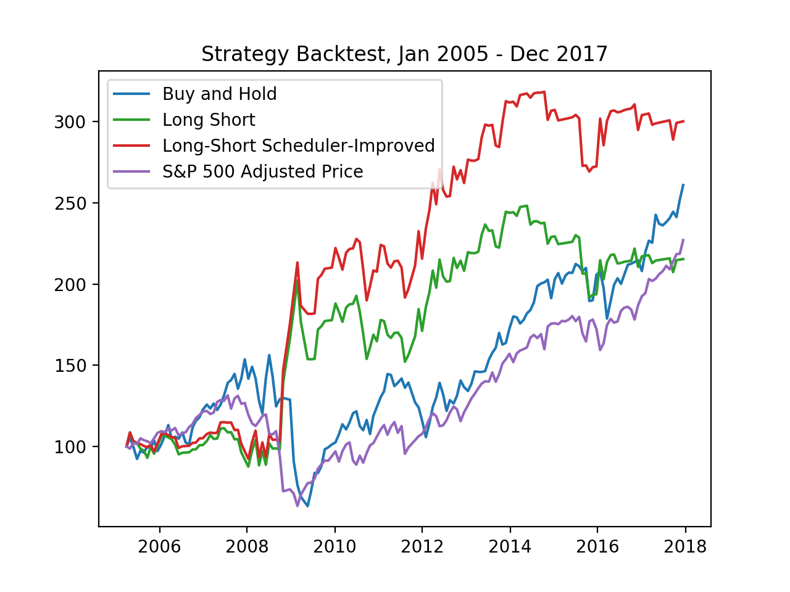
Backtesting on real data

Slide 35
Conclusion
Statistical model checking can be used in portfolio optimization
Optimal schedulers give good real-world insight into when a trading strategy loses money
Extremely important for hedge funds and investment banks
Can be extended to virtually anything that can be expressed as an MDP or state transition diagram
Mortgage pricing, options pricing, lattice-based term-structure modeling

Slide 36
Future Work
Simulate Brownian Motion more accurately
Brownian bridge rather than sequential simulation
Experiment with different world states and trading strategies
Optimize trading strategies with trader and scheduler locked in a two-player zero-sum game
Generative Adversarial Networks (zero-sum game between neural networks)

Slide 37
References
[1] Ermogenous Angeliki. Brownian motion and its applications in the stock market. http://ecommons.udayton.edu/mth_epumd/15, 2006.
[2] Fischer Black and Myron Scholes. The pricing of options and corporate liabilities. Journal of Political Economy, 81(3):637–654, 1973.
[3] Tim Bollerslev. Generalized autoregressive conditional heteroskedasticity. Journal of Econometrics, 31(3):307 – 327, 1986.
[4] Gavin Cassar and Joseph J. Gerakos. Do risk management practices work? evidence from hedge funds. https://papers.ssrn.com/sol3/papers.cfm?abstract_id=1722250, Dec 2010.
[5] Joe Chang. Brownian motion conditional distributions. http://disi.unal.edu.co/~gjhernandezp/mathcomm/slides/bm.pdf. Accessed: 2018-11-18.
[6] D. Henriques, J. G. Martins, P. Zuliani, A. Platzer, and E. M. Clarke. Statistical model checking for markov decision processes. In 2012 Ninth International Conference on Quantitative Evaluation of Systems, pages 84–93, Sept 2012.
[7] D. Henriques, J. G. Martins, P. Zuliani, A. Platzer, and E. M. Clarke. Statistical model checking for markov decision processes. In 2012 Ninth International Conference on Quantitative Evaluation of Systems, pages 84–93, Sept 2012.
[8] Marta Kwiatkowska, Gethin Norman, and David Parker. Prism: Probabilistic symbolic model checker. In Tony Field, Peter G. Harrison, Jeremy Bradley, and Uli Harder, editors, Computer Performance Evaluation: Modelling Techniques and Tools, pages 200–204, Berlin, Heidelberg, 2002. Springer Berlin Heidelberg.
[9] Andrew W. Lo. Risk management for hedge funds: Introduction and overview. https://papers.ssrn.com/sol3/papers.cfm?abstract_id=283308, Sep 2001.
[10] Grant Olney Passmore and Denis Ignatovich. Formal verification of financial algorithms. In Leonardo de Moura, editor, Automated Deduction – CADE 26, pages 26–41, Cham, 2017. Springer International Publishing.
[11] Simon Peyton Jones, Jean-Marc Eber, and Julian Seward. Composing contracts: An adventure in financial engineering (functional pearl). SIGPLAN Not., 35(9):280–292, September 2000.
[12] André Platzer. Stochastic differential dynamic logic for stochastic hybrid programs. In Nikolaj Bjørner and Viorica Sofronie-Stokkermans, editors, Automated Deduction – CADE-23, pages 446–460, Berlin, Heidelberg, 2011. Springer Berlin Heidelberg.17
[13] Dr Reddy and V Clinton. Simulating stock prices using geometric brownian motion: Evidence from australian companies. 10:23–47, 01 2016.
[14] Karl Sigman. Simulating normal (gaussian) rvs with applications to simulating brownian motion and geometric brownian motion in one and two dimensions. http://www.columbia.edu/~ks20/4703-Sigman/4703-07-Notes-BM-GBM-I.pdf. Accessed: 2018-11-18.

Slide 38





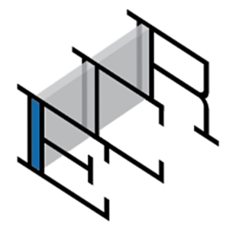




Acknowledgments
Professor André Platzer
TAs Yong Kiam, Irene, Brandon, CPS Lab
Sponsors

